Slide 1

SESHADRI RAO GUDLAVALLERU ENGINEERING COLLEGE (AN AUTONOMOUS INSTITUTE WITH PERMANENT AFFILIATION TO JNTUK, KAKINADA) SESHADRI RAO KNOWLEDGE VILLAGE, GUDLAVALLERU – 521356, KRISHNA DISTRICT DEPARTMENT OF ELECTRONICS AND COMMUNICATION ENGINEERING
INDUSTRIAL/PRACTICAL TRAINING REPORT ON
VOICE BASED HOME AUTOMATION
Project Batch : ECE-IoT-009
Presented by:
20485A0413 - NAZMA SULTANA MOHAMMAD

Slide 2
OBJECTIVE:
The main objective of this project is to use voice commands to execute domiciliary activities.
To help physically challenged and old aged execute task with little mobility using voice commands

Slide 3
ABSTRACT:
Home automation is one of the major growing industries that has the potential to change people's lives. Some of these home automation systems are aimed at those looking for luxurious and advanced home automation platforms, while others are aimed at those with special needs, such as the elderly and the disabled. A typical wireless home automation system allows one to control household appliances from a wireless centralised unit. Most commercially available home automation systems require these appliances to be specially designed to be compatible with each other and with the control unit. The designed system, that can be integrated into a single portable unit, enables wireless control of lights, fans, air conditioners, television sets, security cameras, electronic doors, computer systems, audio/visual equipment, and other devices.

Slide 4
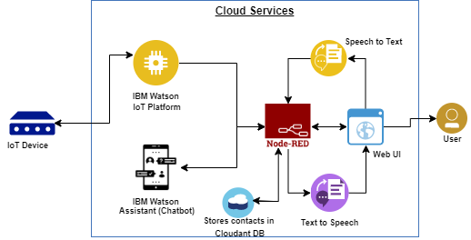
BLOCK DIAGRAM:

Slide 5
TOOLS REQUIRED:
IBM Cloud
IBM Watson IoT Platform
IBM Nodered
Text to Speech Service
Speech to Text Service
IBM Watson Assistant
Python IDE

Slide 6
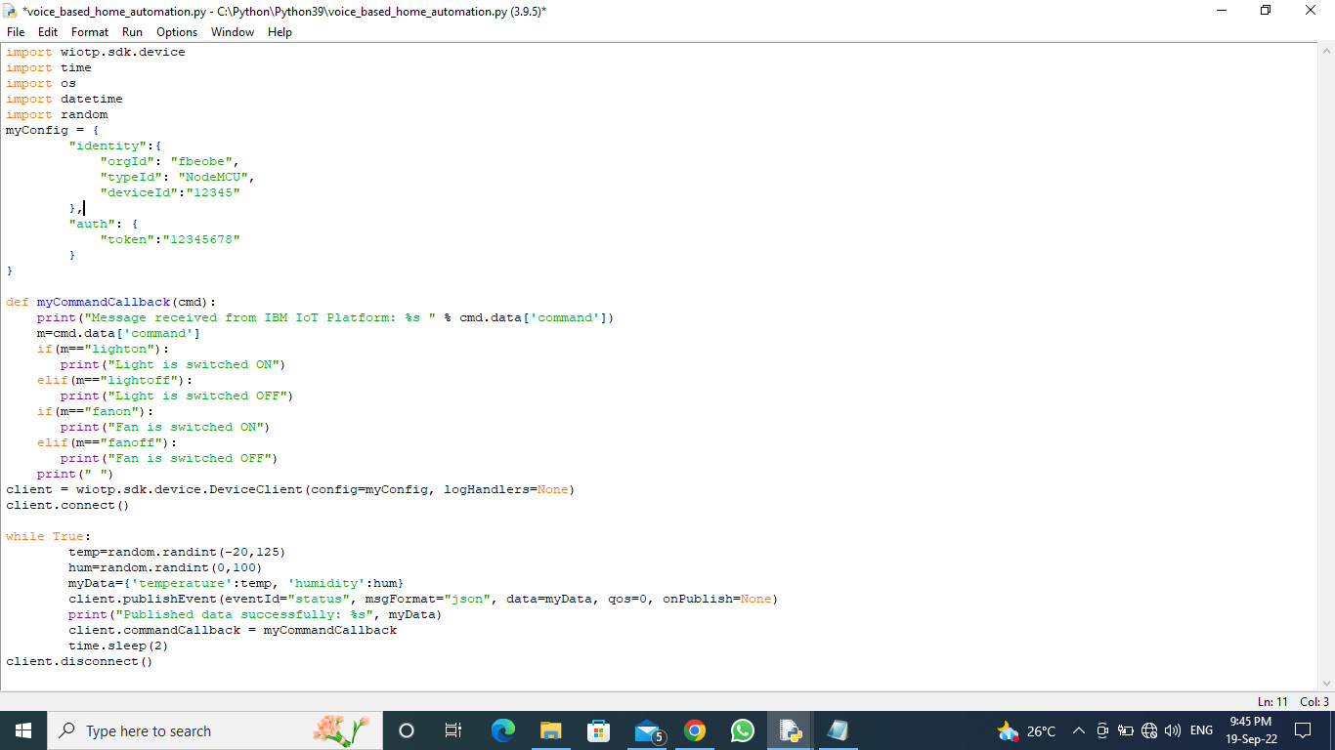
PYTHON CODE:

Slide 7
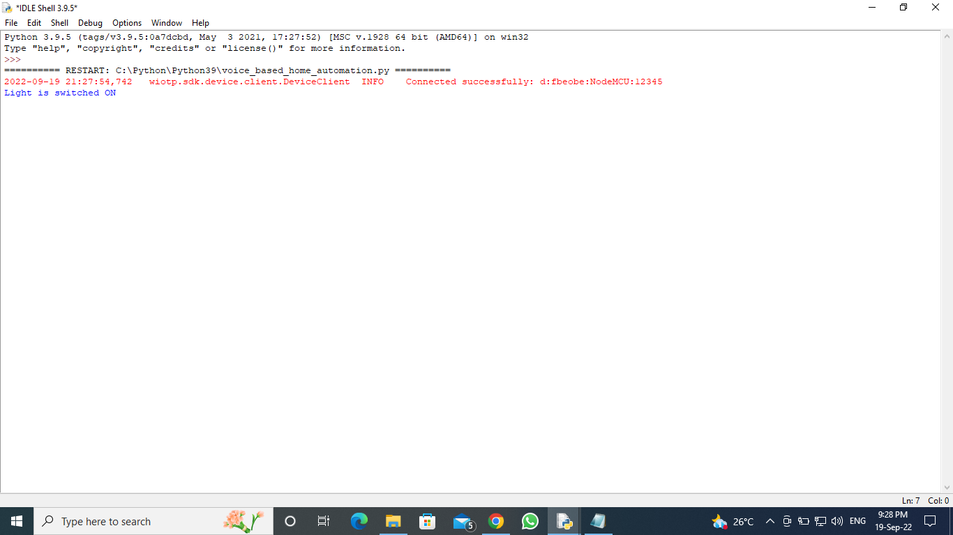
PYTHON CODE OUTPUT:

Slide 8
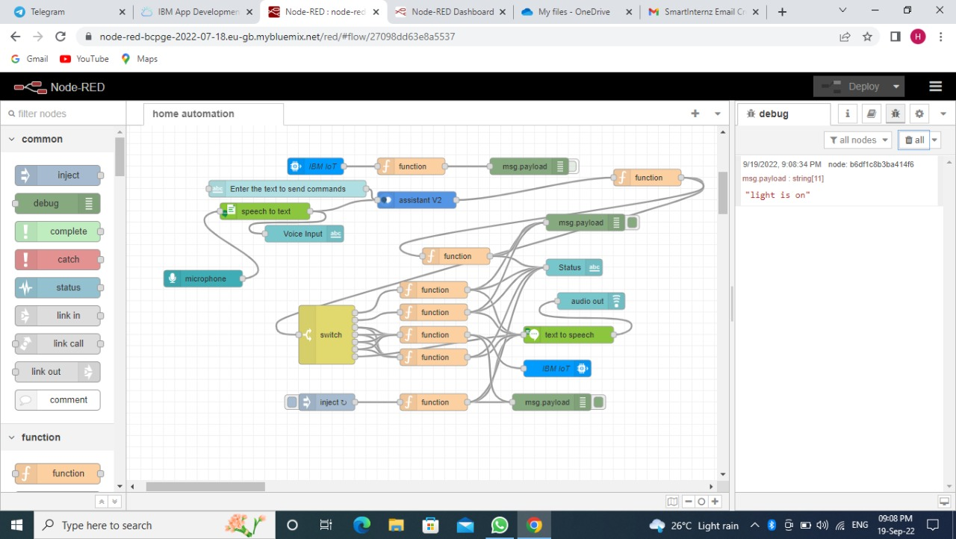
NODE – RED FLOW:

Slide 9
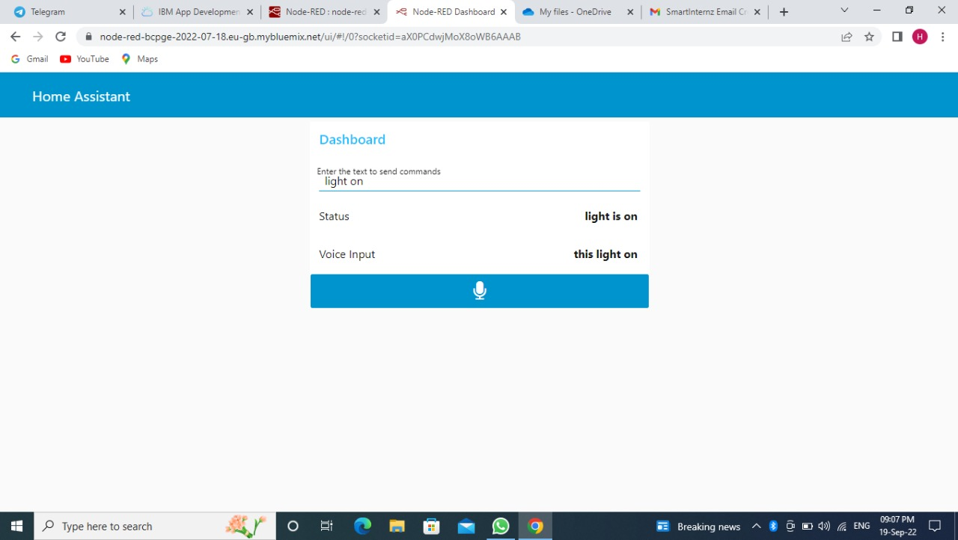
NODE-RED DASHBOARD:

Slide 10
ADVANTAGES:
Devices can be controlled from long distances
Full control over all smart appliances with only one device
Support for the older generation and disabled persons
DISADVANTAGES:
Reliable internet connection is crucial
Not suitable for all type of houses
Maintenance and repair issues

Slide 11
THANK YOU

